Slide 1
High Performance Fabrication & Characterization High Performance Fabrication & Characterization
HTDS Chaminda, GD Vendz, G Floyd
Presenting Author
HTDS Chaminda
Wayamba University of Sri Lanka

Slide 2
How Does it Work?
Here goes descriptions
Here goes data and figures

Slide 3
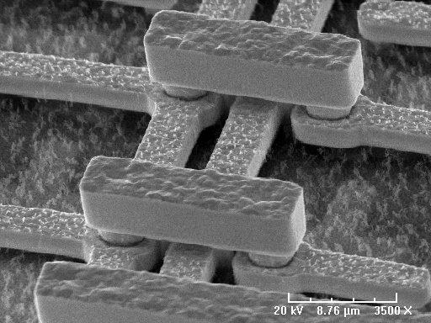

Slide 4
Q&A

